Slide 1
Testing Java Programs – Memory Management Issues
Dr Averil Meehan

Slide 2
Contents
We will first look at what memory management problems can occur in Java code.
Next we will examine reasons why the exact section of code which cause these problems can be very difficult to detect.
We will then consider various approaches to detecting memory management problems before they become severe enough to severely slow or even crash your application.

Slide 3
Automatic Garbage Collection in Java
Memory management problems in object oriented programming languages are so serious that Java provides automatic garbage collection (GC)
This removes many of the serious memory management problems found in other Object Oriented Programming languages
Java uses the Hotspot GC which divides the heap into generational sections
Minor collections of the younger Eden space quickly reclaim structures references by short lived objects.

Slide 4
Problems
Unfortunately there are still problems
  Efficiency problems
  Space Leaks

Slide 5
Memory Problems
Unfortunately memory errors are characterised by:
  Non-deterministic behaviour – not easily repeated
  Difficult to detect by reading code alone

Slide 6
Efficiency Problems
When the heap becomes nearly full, allocation takes more time
If the GC is called often, the pauses while it is carried out can become a problem
This is most serious in
  real time interactive programs,
  or where a constant execution time is important

Slide 7
Cost of Garbage Collection
GC in Java is carried out on a low priority thread.
This enables GC to make use of fee processor time,
but it still has a cost and will pause the program for a short time.
These costs can be significant in programs where objects
  are large in number
  or reference large structures on the heap

Slide 8
bn
n1 1
n2 1
n3 1
n4 1
7
1
1
8
6
1
3
1
1
3
1
1
2
2
5
1

Slide 9
Space Leaks
Garbage is any structure allocated in heap memory but no longer in use, i.e. there is no reference to it from within program code
A space leak occurs when structures allocated on the heap are no longer in use by a program, yet are not identified as such.
The automatic GC does not collect them and their memory resources are not recycled.

Slide 10
Problem Code Includes:
Static reference to an object remains after last use of that object in the program,
Where the Listener fails to de-register when no longer used,
Code contains Thread(s) (utilising objects) that do not terminate when no longer needed
Object finalizer not called (GC only occurs after this) - No guarantee when finalizer (or even if) finalizer will be run.
These are particularly a problem in
  Any code that runs for a long time
  GUI based code (where the order of code execution varies hence it is not always clear when objects, listeners and threads will no longer be required)

Slide 11
When is the Garbage Collector called?
Even if a program has none of these problems, it can still run out of memory.
Full GC is only carried out
  if the programmer puts in code for it, or
  if the memory resources become critically low.
There is still no guarantee when or even if GC will happen.

Slide 12
How Serious are Space Leaks?
The seriousness of space leaks are relative to their size and the running time of the application.
Small space leaks present few problems in short running applications that run on large memories.
But even small space leaks can cause problems if
  the application is scaled up,
  if it runs for a long time, e.g. on a server that runs continuously
  Or if objects refer to large structures on the heap.

Slide 13
Identify memory management problems early
Problem indicators range from system crashes to more subtle variable execution speeds over time
When the program exits with the message:
Exception in thread "main"
java.lang.OutOfMemoryError: Java
heap space
it is too late to do anything about it. The challenge is to detect problems much earlier when something can be done

Slide 14
Implications for Testers
Often the problem will not be evident until the testing stage.
Worse, it may not show until the program goes live.

Slide 15
Implications for Testers
Sometimes the first indication that a problem exists is when the application crashes with the OOME message.
Exception in thread "main"
java.lang.OutOfMemoryError: Java heap space
At this point, it is too late to do anything about it.
The challenge is to detect problems much earlier when something can be done

Slide 16
Implications for Testers
Knowing there is a problem is only the first stage.
It is important to identify the exact cause of the problem.
The rest of this presentation looks at ways
  to identify the existence of memory problems,
  to identify the precise section of code that is causing the problem

Slide 17
Detecting Problems Early
Various approaches covered in the next slides
  Manual Inserts in Code
  Using Command Line Arguments
  Java Monitoring and Management API
  Memory Profile Tools

Slide 18
Manual Inserts in Code
A global counter - updated in the Constuctor gives the number of objects of this class that have been allocated on the heap.
Decrease in finalize() method - the counter now reflects the number of live objects.
Used to check the number of objects that are live.

Slide 19
Manual Inserts in Code
Alternative – use two counters,
  one to record allocations,
  and one to record those that are available for GC.
Problem: The finalize() method leaves the object ready for GC, but there is no guarantee When or even if GC will occur.

Slide 20
Keep track of available memory
Runtime r = Runtime.getRuntime();
float freeMemory = (float) r.freeMemory();
float totalMemory = (float) r.totalMemory();
System.out.println("Total Memory = " + totalMemory);
System.out.println("Free memory = " + freeMemory );
This has the following output when run on a windows OS:
Total Memory = 2031616.0
Free memory = 1868432.0

Slide 21
Reachability and References
An object will only be garbage collected when there is no reference to it.
But sometimes objects are kept by a program in case they are needed later – common on Web based or GUI code.
These structures can be very memory intensive.
A better way is to tell the GC that these structures can be collected if memory gets low, otherwise leave them. If they are found to be null when (or if) they are needed again, they are simply loaded again from disc (or the internet)
The way to do this is by using the Reference class

Slide 22
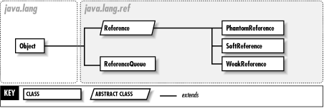
Use the ref Package
http://www.unix.org.ua/orelly/java-ent/jnut/ch13_01.htm

Slide 23
Reachability and References
The Reference class enables you to specify the strength of reach ability of your objects.
A strongly reachable object can be reached by at least one chain of strong references.
An object referred to by a SoftReference may be reclaimed if memory is low. Usually the longer it is in existence the more likely this will happen. A strongly reachable object can be reached by at least one chain of strong references.

Slide 24
Reachability and References
An object referred to by a WeakReference is considered available for GC. First all weak references will be cleared, the object becomes available for finalization, and then it will be reclaimed.
An object referenced by a PhantomReference isn’t reachable – is always null, but there is an object there. Useful with Reference queues
ReferenceQueue class is used to keep track of referenceswhich are about to be cleared, but there is no guarantee when or if GC will happen

Slide 25
Overview - Manual Inserts in Code
Advantages:
  relatively simple to do.
  useful for giving an overview of the whole of a program, for example comparing memory use of objects at the beginning, at key points and also at the end of program execution.

Slide 26
Overview - Manual Inserts in Code
Disadvantages
  the information is limited,
  omits useful details such as the GC algorithm used, or how the different heap spaces are utilised.
  Adds low level memory detail to code – the opposite of the objective of information hiding that is central to the choice of an object oriented programming language in the first place.

Slide 27
Using Command Line Arguments
garbage collection command line argument verbosegc can be used to diagnose problems with garbage collection.
The output gives information on
  the garbage collector
  occupancy of the young generation, and of the entire heap before and after a collection
  the length of pause while GC was carried out

Slide 28
Using Command Line Arguments
java
-verbosegc
-XX:+PrintGCDetails <CLASSFILENAME>
or using a jar file:
java
-verbosegc
-XX:+PrintGCDetails
–jar <JARFILENAME.jar>

Slide 29
HAT
This tool uses a heap dump which is a binary file that can be queried
“The tool allows a number of queries, including "show me all reference paths from the rootset to this object". It is this query that is most useful for finding unnecessary object retention. “
https://hat.dev.java.net/doc/README.html
Includes a description of the tool as well as examples
Notes:
“To generate a .hprof file, you should run java with the -Xrunhprof flag. The format recognized by this program first appeared in JDK 1.2 beta3. HAT must be given a binary hprof file. This is done with the "format=b" modifier to the -Xrunhprof command. For example, to run the program Main and generate a binary heap profile in the file dump.hprof, use the following command:
java -Xrunhprof:file=dump.hprof,format=b Main
To run the hat server program, use the run shell script or batch file provided in the bin directory. You'll probably want to copy it and hat.jar somewhere sensible (I use ~/bin on Unix and OS/X, and c:/bin on Windows). Once that's done, to analyze a slot car hprof file, you can do the following:
cd doc/hprof_files hat -port=7002 slot_car_jdk_1_5_0_beta2.hprof If a port is not specified, it defaults to 7000.
The server can compare two heap dumps, and it's possible to specify a numbered heap dump in the file. For example, to compare the first and second heap dump in slotCar.hprof, use this command:
hat -baseline slot_car_from_jdk_1_2_beta3.hprof#1 slot_car_from_jdk_1_2_beta3.hprof#2 You can specify a file that influences the reachable objects query. This file lists the data members that should be excluded when generating this query. This can be used to determined the size of a given object and all objects reachable from it, excluding observers and other objects that aren't "owned" by the target object. To specify a set of data members to exclude, use the -exclude command line option:
./hat -exclude slotCar.exclude slot_car_from_jdk_1_2_beta3.hprof This file should contain the fully-qualified name of each data member to exclude, with a newline between each data member. If this file is modified while a server is running, it will be re-read.
The program sets itself up as an http server on the port you specify. You access it by bringing up the default page in the browser of your choice. For example, if you're running hat on the same computer as your browser, you can probably call it "localhost", if not "127.0.0.1" will do. Assuming your OS supports calling it localhost, you could access the server started above by navigating to the URL "http://localhost:7002/". From there, you can run other queries by clicking on hyperlinks, or by directly typing in URLs.
From https://hat.dev.java.net/doc/README.html

Slide 30
HAT
HAT requires hprof file in binary format:
To get this use -Xrunhprof flag.
For example
  java -Xrunhprof:
  file=dump.hprof,
  format=b FileName

Slide 31
HAT
Supports simple queries, e.g. "show all instances of class X"
Mustang (Java SE 6) comes with jhat - Java Heap Analysis Tool.
jhat supports OQL - Object Query Language
select <expression> [ from [instanceof] <class name> <identifier> [ where <filter-expression> ] ]
See A. Sundararajan’a blog http://blogs.sun.com/sundararajan/entry/what_s_in_my_java

Slide 32
Problem with this approach
Generates a lot of data.
Print statements inserted at specific points in the code will be output along with the GC statistics helps match the statistics to specific sections of code

Slide 33
Java Monitoring and Management API
From Java 1.5, the Java Monitoring and Management API provides a way to monitor memory usage and GC statistics.
There is much more to this API, but only these aspects are considered here.
This includes the monitoring programs
  jstat
  JConsole
  as well as Mbeans.

Slide 34
jstat
Previously called jvmstat
Usage:
  jstat -gc <jvmid>
C:\mmtest>jstat –gcutil 1608 >> gcresults.txt
Gives information on how the various sections of the heap are used as well as the number and times GC occurs

Slide 35
Mbeans
The Java Management Extension (JMX) API is now integrated with J2SE.
GC monitoring is achieved using Mbeans, java objects which represent resources.
When an Mbean is registered in a Mbean Server it becomes an agent.
All registered Mbeans can be seen in JConsole (a GUI tool that is looked at later)

Slide 36
Package java.lang.management
http://java.sun.com/j2se/1.5.0/docs/api/java/lang/management/package-summary.html

Slide 37
Package java.lang.management
Management interfaces
  ClassLoadingMXBean – for class loading system of the JVM.
  CompilationMXBean – for compilation system of the JVM.
  GarbageCollectorMXBean for the garbage collection of JVM
  MemoryManagerMXBean- for a memory manager.

Slide 38
Package java.lang.management
Management interfaces
.
  MemoryMXBean - for the memory system of the JVM.
  MemoryPoolMXBean - for a memory pool.
  OperatingSystemMXBean - for the operating system on which the JVM is running.
  RuntimeMXBean - for the runtime system of the JVM.
  ThreadMXBean - for the thread system of the JVM.

Slide 39
Package java.lang.management
Class Summary
ManagementFactory used for getting managed beans for the Java platform.
ManagementPermission - The permission which the SecurityManager will check when code that is running with a SecurityManager calls methods defined in the management interface for the Java platform.
MemoryNotificationInfo for information about a memory notification.
MemoryUsage - represents snapshot of memory use
ThreadInfo - Thread information.

Slide 40
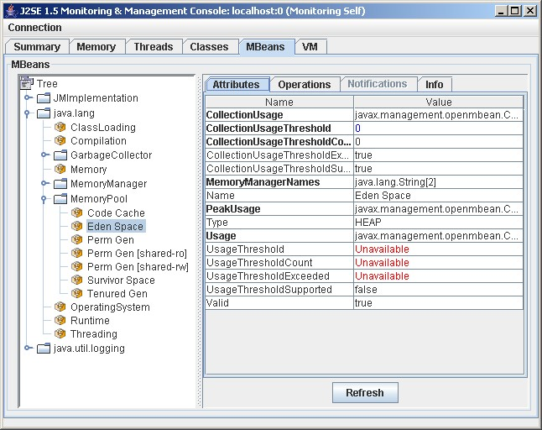

Slide 41
Mbeans
Sun’s java.lang.management contains many useful classes that can be used to monitor memory levels.
For example the MemoryMXBean includes the interface
javax.management.NotificationEmitter
which can be used for notifications of the type:
MEMORY_THRESHOLD_EXCEEDED
which can be implemented on a thread

Slide 42
MBeans
For example:
public interface GarbageCollectorMXBean extends MemoryManagementMXBean
This interface can be used to detect the total number of collections
( getCollectionCount() )
and the time this took
(getCollectionTime() )

Slide 43
MemoryMXBean
public interface MemoryMXBean {
public MemoryUsage getHeapMemoryUsage();
public MemoryUsage getNonHeapMemoryUsage();
public int getObjectPendingFinalizationCount();
public boolean isVerbose();
public void setVerbose(boolean value);
public void gc();
}
http://java.sun.com/j2se/1.5.0/docs/api/java/lang/management/MemoryMXBean.html
Notes:
gc() is the same as System.gc() – calls garbage collector

Slide 44
MemoryUsage class
For MemoryUsage class see http://java.sun.com/j2se/1.5.0/docs/api/java/lang/management/MemoryUsage.html
A MemoryUsage object represents memory usage.
Attributes:
  init - initial amount of memory (in bytes)
  used - memory currently used (in bytes).
  committed - memory (in bytes) that is guaranteed to be available for use by the Jvm
  max - maximum memory (in bytes) that can be used for memory management

Slide 45
Mbeans
MBeans can be used as listeners which send a warning message when memory levels become low, hopefully in time to prevent a system crash.
However, when this was tried, it worked well in some test programs,
but others that allocated a lot of objects, or whose objects references large structures, the warning message often did not occur, or if it did it was too late to prevent a crash.

Slide 46
JConsole
GUI tool that sits on top of the new Monitoring and Management API
Provides information on
  memory use,
  garbage collections,
  threads,
  classes,
  and Mbeans.
JConsole uses JMX to monitor the JVM and can be used either locally or remotely.
Included with JDK 5 and with Mustang

Slide 47
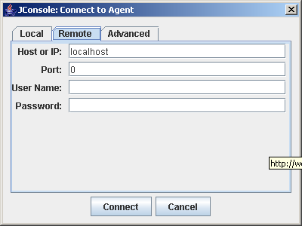

Slide 48
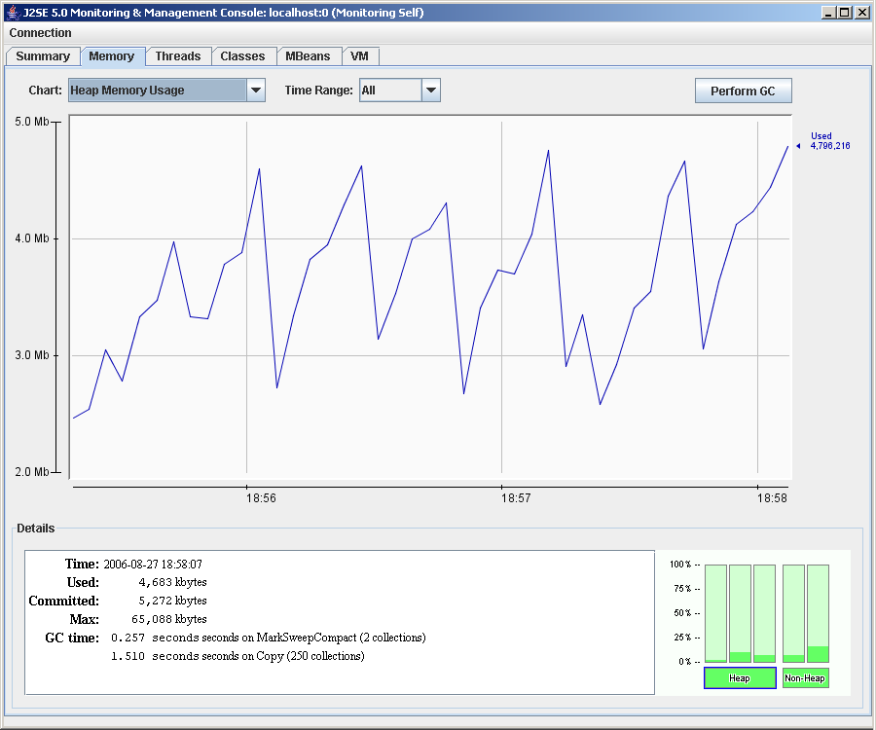

Slide 49
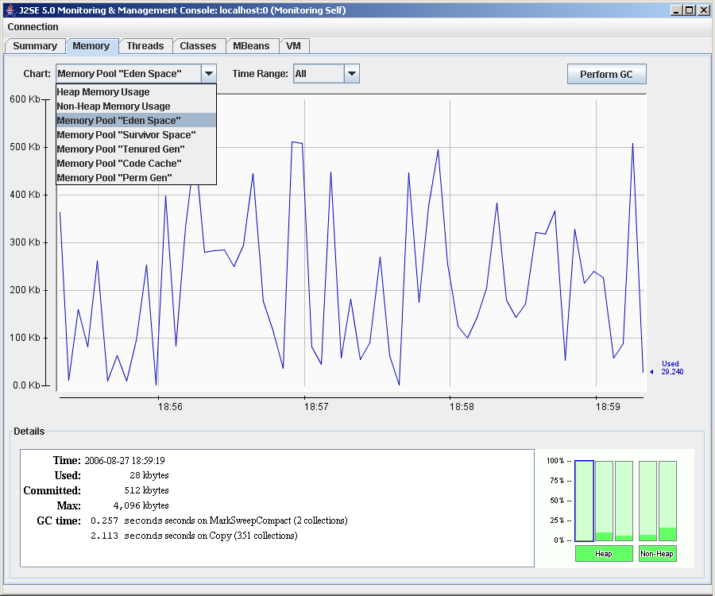

Slide 50
Mustang JConsole
JConsole Plugin Support
Dynamic Attach Capability – can attach to any applications running on Mustang JDK
UI Improvements
Overview Tab and VM Summary Tab
HotSpot Diagnostic Mbean - to request heap dump at runtime and also change the setting of certain VM options
For more information see Mandy Chung’s page
http://weblogs.java.net/blog/mandychung/archive/2006/05/mustang_jconsol_1.html

Slide 51
Memory Profile Tools
Examples include:
  JProbe Memory Debugger
  or GCspy
Visual tools graphically chart heap use as peaks and troughs as objects are created and destroyed.
Such tools slow down execution too much to be used in a final product but they are useful during development to highlight problem areas.

Slide 52
NetBeans Profiler
Can be used to monitor
  Heap memory size
  Garbage collection statistics
  Thread count
  Thread state
As the program runs
http://profiler.netbeans.org/
Tutorial - http://www.netbeans.org/kb/articles/nb-profiler-tutor-8.html

Slide 53
VisualGC
Integrated in Netbeans using Milestone –
Opens inside the IDE
User is prompted for the PID. This can be got using jps at command line
New version Milestone2 provides this in combo box – user selects
For download, information and screenshots see:
http://management.netbeans.org/visualgc/index.html

Slide 54
Java SE 6 Beta 2 (Mustang)
http://java.sun.com/javase/6/
  Improved JMX Monitoring API
  Improved memory usage analysis and lea
Jconsole is included
Download JDK 6 Beta 2 from:
http://java.sun.com/javase/downloads/ea.jsp
  detection

Slide 55
Resources - Java SE Monitoring
jmap - Memory Map
http://java.sun.com/j2se/1.5.0/docs/tooldocs/share/jmap.html
jhat - Java Heap Analysis Tool http://java.sun.com/javase/6/docs/technotes/tools/share/jhat.html
https://hat.dev.java.net/doc/README.html (HAT)
jstack - Stack Trace http://java.sun.com/j2se/1.5.0/docs/tooldocs/share/jstack.html

Slide 56
Resources - Java SE Monitoring
jstat - Java Virtual Machine Statistics Monitoring Tool http://java.sun.com/j2se/1.5.0/docs/tooldocs/share/jstat.html
jconsole - Java Monitoring and Management Console http://java.sun.com/j2se/1.5.0/docs/tooldocs/share/jconsole.html
http://java.sun.com/developer/technicalArticles/J2SE/jconsole.html

Slide 57
Bloggers
Mandy Chung ‘s “From Monitoring to Diagnosing Memory Problem in Mustang” February 15, 2006
http://weblogs.java.net/blog/mandychung/archive/2006/02/from_monitoring_1.html
Gregg Sporar's on Netbeans and Milestone
http://weblogs.java.net/blog/gsporar/
A. Sundararajan's Weblog
http://blogs.sun.com/sundararajan/entry/what_s_in_my_java

Slide 58
Resources - Mustang
Monitoring and Management
http://download.java.net/jdk6/docs/technotes/guides/management/
jhat - Java Heap Analysis Tool http://download.java.net/jdk6/docs/technotes/guides/management/overview.html

Slide 59
Conclusions
Early detection of memory management problems is important – the earlier the problem is found, the easier it is to do something about it.
Various approaches, but the use of JConsole during development and testing is recommended.
What works best may depend on the particular application, but it is important for the programmer to be aware of what their options are.

Slide 60
Questions??

